Slide 1
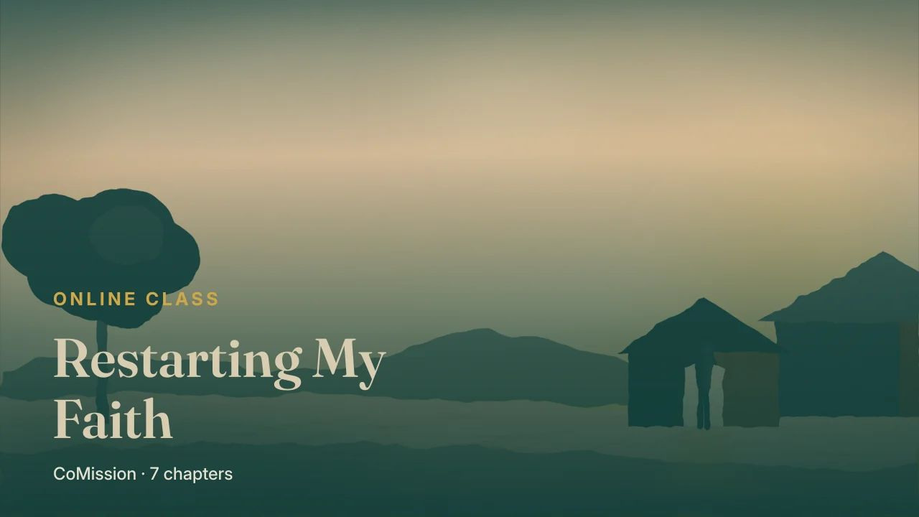
Notes:
The Father running

Slide 2
BEFORE ONE MORE STEP
What picture of God
are you carrying?
Notes:
Before you take one more step toward God, ask yourself what picture of Him you're carrying.

Slide 3
It shapes how you
come back.
Notes:
Because that picture shapes everything about how you come back to Him.

Slide 4
THE PICTURE MANY CARRY
Arms folded.
Standing in the doorway.
Notes:
For a lot of folks coming home, it's a disappointed parent, arms folded, standing in a doorway, waiting for the explanation.

Slide 5
“You say your piece.
He decides.”
Notes:
You walk up slowly. You say your piece. And He decides.

Slide 6
JESUS PAINTS IT DIFFERENTLY
And He does it
on purpose.
Notes:
Jesus paints a completely different picture. And He paints it on purpose.

Slide 7
“
So he arose and went to his father. But while he was still a long way off, his father saw him and was filled with compassion; he ran to his son, embraced him, and kissed him.
LUKE 15:20 · OTB
Notes:
Here it is, in Luke fifteen, verse twenty. So he arose and went to his father. But while he was still a long way off, his father saw him and was filled with compassion; he ran to his son, embraced him, and kissed him.

Slide 8
ONE PIECE AT A TIME
While he was still
a long way off.
Notes:
Take that one piece at a time. While he was still a long way off.

Slide 9
Just a figure
on the road.
Notes:
The son hasn't arrived. He hasn't said a word. He's just a figure on the road.

Slide 10
HIS FATHER SAW HIM
Which means
he was looking.
Notes:
His father saw him. Which means the father was looking. You don't spot somebody that far off by accident.

Slide 11
“He was watching
the road.”
Notes:
He was watching the road. For how long, the story doesn't say. Long enough.

Slide 12
NOT
BUT
irritation,
or a list
compassion
Notes:
Filled with compassion. Not irritation. Not a list of what the son had cost him. Compassion, the kind you feel in your gut.

Slide 13
AND THEN
He ran.
Notes:
And then, he ran.

Slide 14
IN THAT CULTURE
A grown man
did not run.
Notes:
In that culture, the head of a household didn't run. It was undignified. He'd have to hitch up his robe in front of the whole village.

Slide 15
He closed the
distance himself.
Notes:
He ran anyway. He closed the distance himself.

Slide 16
Before a word
of the speech.
Notes:
Embraced him, and kissed him. Before a word of the speech. Before any promise to do better.

Slide 17
“The welcome
came first.”
Notes:
The welcome came first.

Slide 18
“
And the Pharisees and the scribes were complaining, saying, “This man welcomes sinners and eats with them.”
LUKE 15:2 · OTB
Notes:
Now remember who Jesus was talking to when He told this. Luke fifteen, verse two. And the Pharisees and the scribes were complaining, saying, This man welcomes sinners and eats with them.

Slide 19
JESUS' ANSWER
This is what God
is like toward you.
Notes:
This story is His answer. This is what God is like toward the one coming home.

Slide 20
NOT THE QUESTION
THE QUESTION
does it
feel true?
did Jesus
give it?
Notes:
So if your picture is folded arms in a doorway, the question isn't whether it feels true. It's whether Jesus gave it. He didn't.

Slide 21
WHY IT MATTERS
Your picture decides
how you pray.
Notes:
And here's why it matters which picture you carry. It decides how you pray.

Slide 22
IF HIS ARMS ARE FOLDED
Prayer becomes
a performance.
Notes:
If God is waiting with folded arms, prayer turns into a performance. Get the words right. Sound sorry enough. Prove you're serious.

Slide 23
Less, and less,
until you stop.
Notes:
And since you can never be sure you did it well enough, you pray less, and less, until you stop.

Slide 24
FOLDED ARMS
THE FATHER WHO RAN
prayer is
a performance
prayer is
just talking
Notes:
But if God is the Father who ran, prayer is just talking to Him. Honestly. Briefly. Often. You don't have to perform your way into a welcome that's already happened.

Slide 25
ROMANS 8:15
Abba,
Father.
Notes:
The New Testament gives believers a word for this. Paul says God's Spirit leads us to cry out, Abba, Father. It's the word a child uses for their dad.

Slide 26
THE FIRST THING THE SPIRIT DOES
The right name
for God.
Notes:
We'll come back to that next chapter; it's the key to how God changes a person. For now, notice this. The first thing the Spirit does isn't correct your behavior. It's give you the right name for God.

Slide 27
“He was watching
the road.”
Notes:
He was watching the road.

Slide 28
EVERY DAY THIS WEEK
Start with Father.
Tell Him what's true.
Notes:
So here's your week. Speak to God as Father every day. Morning, evening, in the car, whenever. Start each prayer with Father, and just tell Him what's true.

Slide 29
TRY IT
Pray to Him as Father.
He already ran.
COMISSION
Notes:
Don't perform. He already ran. Pick your start day, and name somebody you'll tell what you noticed.

