Slide 1
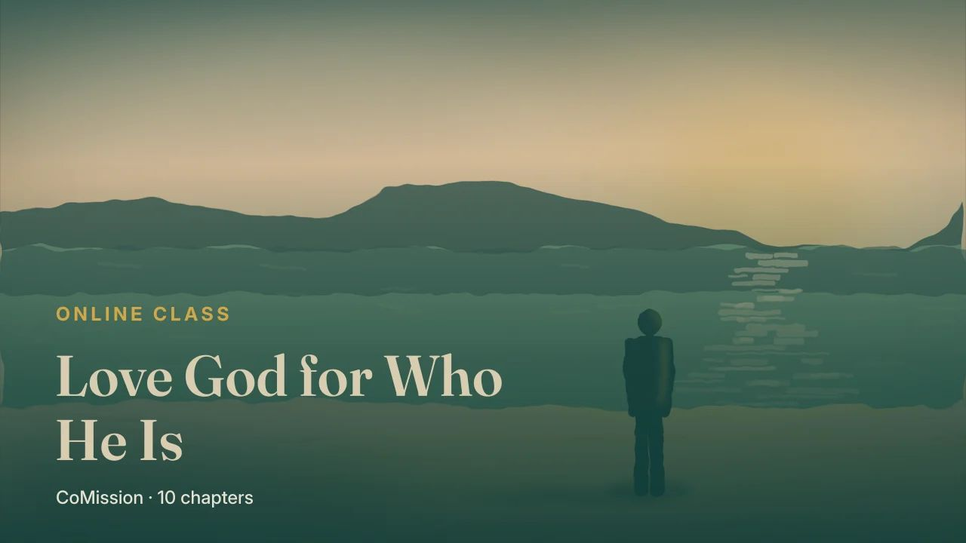
Notes:
Knowing God changes why you seek Him

Slide 2
KNOWING GOD CHANGES WHY YOU SEEK HIM
Where do you
get to know Him?
Notes:
If love grows out of knowing God, the next question is practical. Where do you get to know Him?

Slide 3
IN HIS WORD
The wrong way
round.
Notes:
The answer is the one you'd expect, in His Word. But most of us take it in the wrong way round.

Slide 4
HOW MOST OF US READ
What should I do?
What should I stop?
Notes:
When many believers open the Bible, they're looking for instructions. What should I do? What should I stop doing?

Slide 5
A good
question.
Notes:
That's a good question, and the Bible answers it.

Slide 6
MANY
VERY LITTLE
rules
about the One
who gave them
Notes:
But if it's the only question you ask, you can spend years in the Bible and come away knowing many rules, and very little about the One who gave them.

Slide 7
First ask
who God is.
Notes:
So before you ask what to do, ask who God is.

Slide 8
TAKE THESE TO ANY PASSAGE
Four
questions.
Notes:
Here are four questions to take with you to any passage.

Slide 9
Who is God here?
What's He like?
Notes:
What does this passage show me about who God is? What does it reveal about His character?

Slide 10
What's God
doing here?
Notes:
What's God doing here, and what does that teach me about Him?

Slide 11
ONLY
ALSO
what I
should do
who God is
Notes:
And am I only learning what I should do, or also who God is?

Slide 12
Eat → Digest → Grow
EAT IT
read · read again · tell it back
DIGEST IT
the four questions
GROW
God gives the growth
Notes:
If you've done a Discovery Bible Study, you'll recognise this. It's the Digest step of Eat, Digest, Grow.

Slide 13
Eat it
EAT IT
read · read again · tell it back
DIGEST IT
the four questions
GROW
God gives the growth
Notes:
You eat the passage by going through it, going through it again, and retelling it in your own words.

Slide 14
DIGEST IT
1
What does this teach me about God?
2
3
4
Notes:
Then you digest it with the questions, and the first one is always, what does this teach me about God?

Slide 15
God gives the growth
EAT IT
read · read again · tell it back
DIGEST IT
the four questions
GROW
God gives the growth
Notes:
This chapter just asks you to slow down on that one. And grow is God's part, not yours.

Slide 16
TRY IT
A small
passage.
Notes:
Try it now, on a small passage from First John four.

Slide 17
“
This is how the love of God was revealed among us: God sent His only Son into the world so that we might live through Him. This is love: not that we loved God, but that He loved us and sent His Son to be the atoning sacrifice for our sins.
1 JOHN 4:9–10 · OTB
Notes:
This is how the love of God was revealed among us: God sent His only Son into the world so that we might live through Him. This is love: not that we loved God, but that He loved us and sent His Son to be the atoning sacrifice for our sins.

Slide 18
What does this
show me about God?
Notes:
Go through it twice. Say it back in your own words. Then, before you think about what to do, ask what it shows you about God.

Slide 19
Stay there
a while.
Notes:
Let yourself stay there a while.

Slide 20
He moves first.
He gives what costs Him most.
Notes:
He moves first. He gives what costs Him most. And He does it for people who hadn't loved Him yet.

Slide 21
A God it's
possible to love.
Notes:
That's a God it's possible to love.

Slide 22
ONE ATTRIBUTE AT A TIME
Faithfulness. Patience.
Mercy. Holiness.
Notes:
You don't have to understand everything about God at once. Pick one thing about Him. His faithfulness, His patience, His mercy, or His holiness.

Slide 23
In the Bible.
In your day.
Notes:
Watch for it this week. Notice it in the Bible, and notice it in your day.

Slide 24
“First ask who God is.
Then ask what to do.”
Notes:
Here's the line to carry this week. First ask who God is. Then ask what to do.

Slide 25
THIS WEEK
One attribute.
Every day.
Notes:
This week, choose one attribute of God you'd like to know better, and look for it in your Bible every day.

Slide 26
TRY IT
A day to start.
A person to tell.
COMISSION
Notes:
Write down why knowing that about Him would help you love Him. Put a day on your start, and tell one person what you find.

