Slide 1
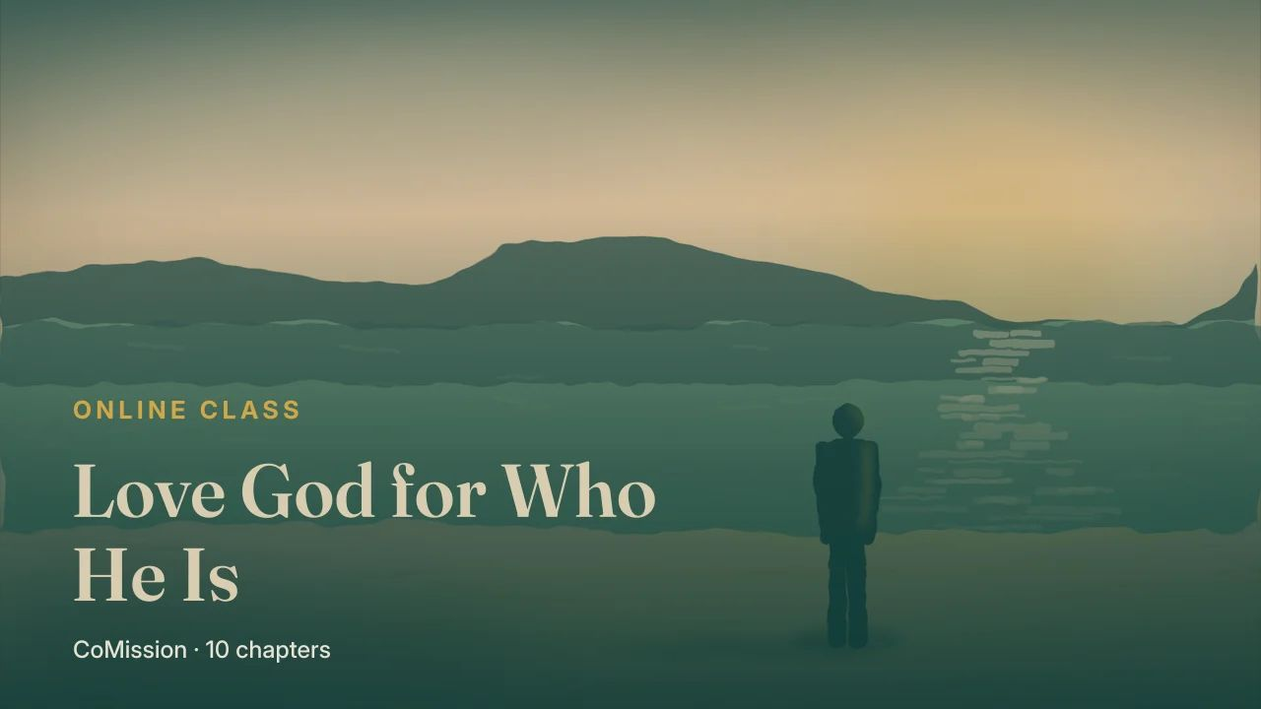
Notes:
Hard to love a God you can't see

Slide 2
HARD TO LOVE A GOD YOU CAN'T SEE
Someone I've
never seen?
Notes:
Here's a fair objection, and a lot of people carry it quietly. How am I supposed to love someone I've never seen?

Slide 3
God isn't in the room
that way.
Notes:
You can love your children, because you can hold them. God isn't in the room in that way.

Slide 4
PETER
HIS READERS
walked with
Jesus
never
saw Him
Notes:
Peter was writing to people with the same problem. He'd walked with Jesus. They hadn't.

Slide 5
“
And though you have not seen Him, you love Him, and though you do not see Him now, but believe in Him, you greatly rejoice with joy beyond words and full of glory.
1 PETER 1:8 · OTB
Notes:
And though you have not seen Him, you love Him, and though you do not see Him now, but believe in Him, you greatly rejoice with joy beyond words and full of glory.

Slide 6
NOT AN INSTRUCTION
Already
happening.
Notes:
Peter isn't telling them to try. He's telling them what's already happening.

Slide 7
It can
be done.
Notes:
They haven't seen Him, and they love Him anyway. So it can be done.

Slide 8
HOW IT HAPPENS
By knowing
them.
Notes:
So how do you come to love someone you can't see? By knowing them.

Slide 9
FAR AWAY
A grandmother
on the phone.
Notes:
Think about someone you love who lives far away. A grandmother you only talk to on the phone. A friend overseas.

Slide 10
NOT BECAUSE
BECAUSE
they're in
front of you
you know
them
Notes:
You don't love them because they're in front of you. You love them because you know them.

Slide 11
How they laugh.
What they care about.
Notes:
How they laugh. What they care about. What they did for you. How they treat people.

Slide 12
Not seeing Him
with your eyes.
Notes:
It's the same with God. The relationship doesn't depend on seeing Him with your eyes.

Slide 13
IT DEPENDS ON
His character. His Word.
His work.
Notes:
It depends on knowing His character, believing His Word, and learning to recognise His work.

Slide 14
IN THE BIBLE
IN YOUR DAYS
what He's like,
what He's said
what He's
doing
Notes:
Knowing His character means knowing what He's like. Believing His Word means trusting what He's said. Recognising His work means noticing what He's doing, in the Bible and in your own ordinary days.

Slide 15
There's
a trap.
Notes:
But there's a trap here.

Slide 16
KNOWING ABOUT
KNOWING
answers, doctrines,
verses
Him
Notes:
You can know a lot of facts about God. The right answers, the doctrines, the verses. And still not know Him.

Slide 17
“Height. Birthday. Address.
Never talked to him.”
Notes:
That's like knowing a man's height, his birthday and his address, and never once talking to him.

Slide 18
Who He
actually is.
Notes:
What you're after is discovering who He actually is.

Slide 19
DISCOVER
What's He like?
What makes Him glad?
Notes:
His character. What's He like? What He loves. What makes Him glad?

Slide 20
DISCOVER
Faithfulness. Mercy.
Justice. Holiness.
Notes:
What He values. What does He care about that you don't? And His faithfulness, His mercy, His justice, and His holiness.

Slide 21
The more you'll
find to love.
Notes:
The more of that you see, the more you'll find to love.

Slide 22
NOT
BUT
a definition
a person
Notes:
People don't love a definition. They love a person.

Slide 23
“I come to love God
by coming to know Him.”
Notes:
Here's the line to carry this week. I come to love God by coming to know Him.

Slide 24
THIS WEEK
Love someone
I can't see?
Notes:
This week, answer two questions in writing. First, what does it mean to me to love someone I can't see?

Slide 25
What do I need
to know about God?
Notes:
And second, what do I need to know about God, so I can love Him more?

Slide 26
TRY IT
A day to write.
A person to talk with.
COMISSION
Notes:
Put a day on the writing, and talk your answers over with one person.

